Slide 1
Vector Mechanics For Engineers: Dynamics Twelfth Edition
Copyright © 2020 McGraw Hill , All Rights Reserved.
PROPRIETARY MATERIAL © 2020 The McGraw Hill Inc. All rights reserved. No part of this PowerPoint slide may be displayed, reproduced or distributed in any form or by any means, without the prior written permission of the publisher, or used beyond the limited distribution to teachers and educators permitted by McGraw Hill for their individual course preparation. If you are a student using this PowerPoint slide, you are using it without permission.

Slide 2
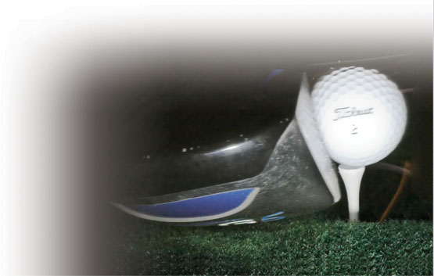
Chapter 13
Kinetics of Particles: Energy and Momentum Methods

Slide 3
Contents
Introduction
Work of a Force
Principle of Work & Energy
Applications of the Principle of Work & Energy
Power and Efficiency
Sample Problem 13.1
Sample Problem 13.2
Sample Problem 13.3
Sample Problem 13.6
Sample Problem 13.7
Potential Energy
Conservative Forces
Conservation of Energy
Motion Under a Conservative Central Force
Sample Problem 13.8
Sample Problem 13.10
Sample Problem 13.12
Principle of Impulse and Momentum
Impulsive Motion
Sample Problem 13.13
Sample Problem 13.16
Sample Problem 13.17
Impact
Direct Central Impact
Oblique Central Impact
Problems Involving Multiple Principles
Sample Problem 13.19
Sample Problem 13.20
Sample Problem 13.21
Sample Problem 13.22

Slide 4
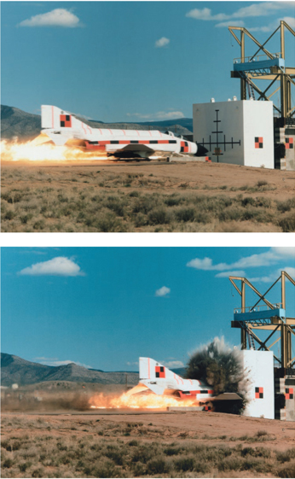
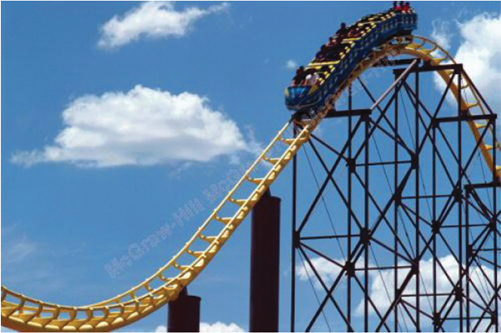
Energy and Momentum Methods
The potential energy of the roller coaster car is converted into kinetic energy as it descends the track.
Impact tests are often analyzed by using momentum methods.
© Dynamic Graphics/Superstock RF, © Sandia National Laboratories/Getty Images RF

Slide 5
Introduction 1
Previously, problems dealing with the motion of particles were solved through the fundamental equation of motion,
The current chapter introduces two additional methods of analysis.
Method of work and energy: directly relates force, mass, velocity and displacement.
Method of impulse and momentum: directly relates force, mass, velocity, and time.

Slide 6
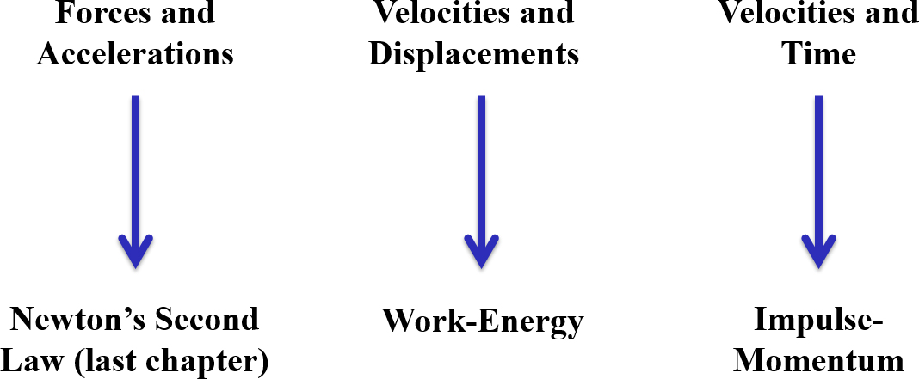
Introduction 2
Approaches to Kinetics Problems
© Tony Hertz/ Alamy

Slide 7
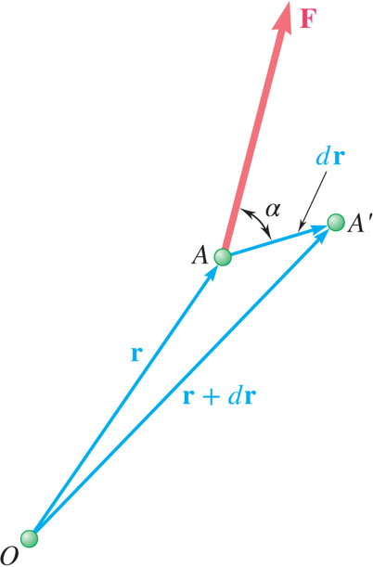
Work of a Force 1
Differential vector
is the particle displacement.
Work of the force is
Work is a begin underline scalar end underline quantity, that is, it has magnitude and sign but not direction.
Dimensions of work are length×force. Units are

Slide 8
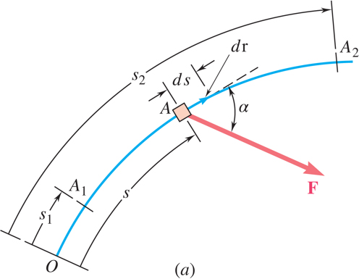
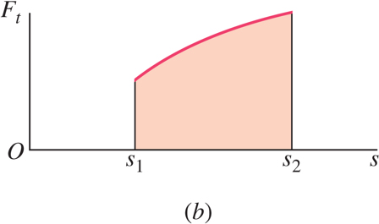
Work of a Force 2
Work of a force during a finite displacement,
Work is represented by the area under the curve of F_{t} plotted against s.
F_{t} is the force in the direction of the displacement ds

Slide 9
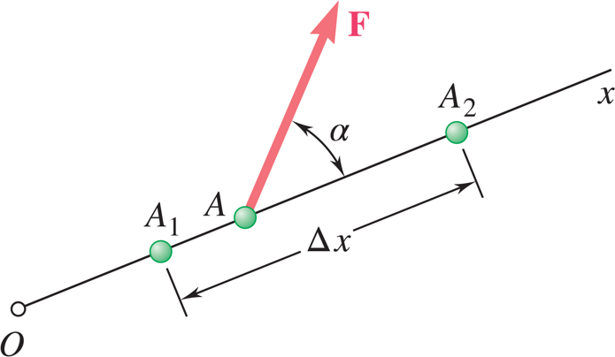
Work of a Force 3
What is the work of a constant force in rectilinear motion?
a)
b)
c)
d)

Slide 10
Work of a Force 4
What is the work of a constant force in rectilinear motion?
a)
b) Answer
c)
d)

Slide 11
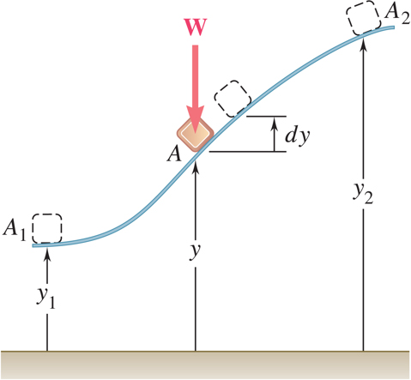
Work of a Force 5
Work of the force of gravity,
Work of the weight is equal to product of weight W and vertical displacement Δy.
In the figure above, when is the work done by the weight positive?
a) Moving from y₁ to y₂
b) Moving from y₂ to y₁
c) Never

Slide 12
Work of a Force 6
Work of the force of gravity,
Work of the weight is equal to product of weight W and vertical displacement Δy.
In the figure above, when is the work done by the weight positive?
a) Moving from y₁ to y₂
Answer: b) Moving from y₂ to y₁
c) Never

Slide 13
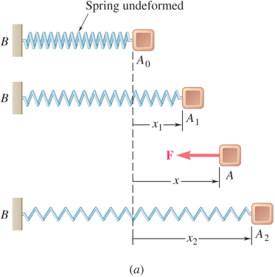
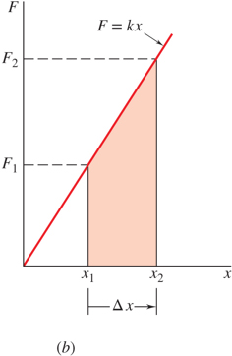
Work of a Force 7
Magnitude of the force exerted by a spring is proportional to deflection,
Work of the force exerted by spring,
Work of the force exerted by spring is positive
when
, that is, when the spring is returning to
its undeformed position.
Work of the force exerted by the spring is equal to negative of area under curve of F plotted against x,

Slide 14
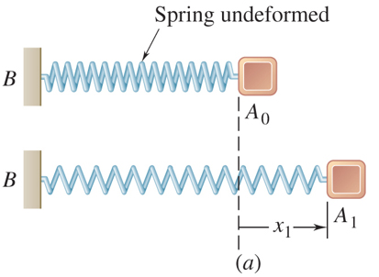
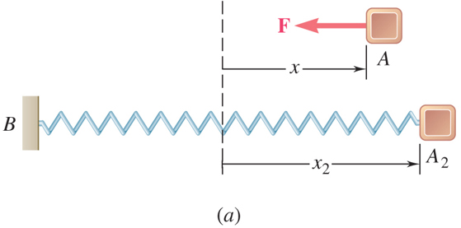
Work of a Force 8
Displacement is in the opposite direction of the force
As the block moves from A₀ to A₁, is the work positive or negative?
Positive
Negative
As the block moves from A₂ to A_{o}, is the work positive or negative?
Positive
Negative

Slide 15
Work of a Force 9
Displacement is in the opposite direction of the force
As the block moves from A₀ to A₁, is the work positive or negative?
Positive
Answer: Negative
As the block moves from A₂ to A_{o}, is the work positive or negative?
Answer: Positive
Negative

Slide 16
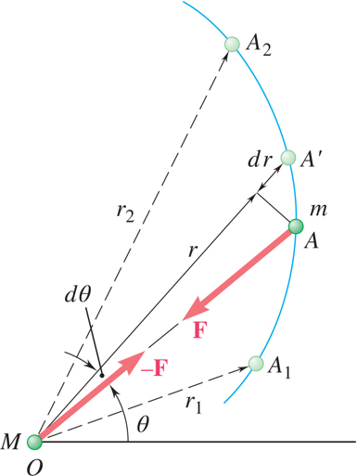
Work of a Force 10
Work of a gravitational force (assume particle M occupies fixed position O while particle m follows path shown),

Slide 17
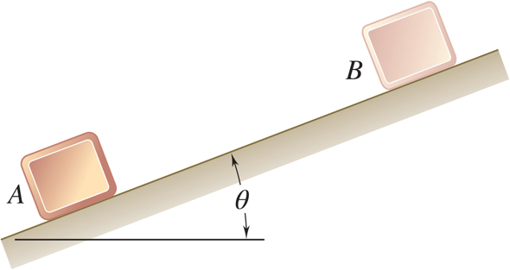
Work of a Force 11
Does the normal force do work as the block slides from B to A?
YES
NO
Does the weight do work as the block slides from B to A?
Positive
or
Negative work?
YES
NO

Slide 18
Work of a Force 12
Does the normal force do work as the block slides from B to A?
YES
Answer: NO
Does the weight do work as the block slides from B to A?
Positive
or
Negative work?
Answer: YES
NO

Slide 19
Work of a Force 13
Forces which do not do work
Reaction at frictionless pin supporting rotating body,
Reaction at frictionless surface when body in contact moves along surface,
Reaction at a roller moving along its track, and
Weight of a body when its center of gravity moves horizontally.

Slide 20
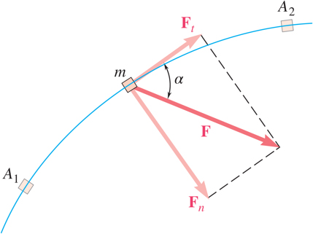
Principle of Work & Energy
Consider a particle of mass m acted upon by force
Integrating from A₁ to A₂ ,
The work of the force
is equal to the change in
kinetic energy of the particle.
Units of work and kinetic energy are the same:

Slide 21
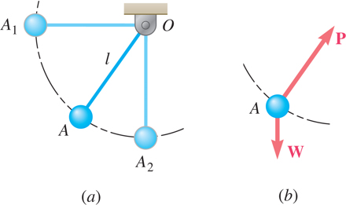
Applications of the Principle of Work and Energy 1
Force
acts normal to path and does no
work.
The bob is released from rest at position A₁. Determine the velocity of the pendulum bob at A₂ using work & kinetic energy.
Velocity is found without determining expression for acceleration and integrating.
All quantities are scalars and can be added directly.
Forces which do no work are eliminated from the problem.

Slide 22

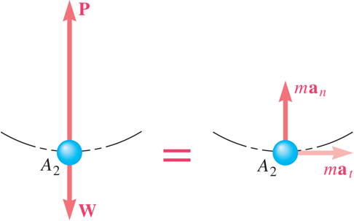
Applications of the Principle of Work and Energy 2
Principle of work and energy cannot be applied to directly determine the acceleration of the pendulum bob.
Calculating the tension in the cord requires supplementing the method of work and energy with an application of Newton’s second law.
As the bob passes through A₂ ,
If you designed the rope to hold twice the weight of the bob, what would happen?

Slide 23
Power and Efficiency
Power = rate at which work is done.
Dimensions of power are work/time or force*velocity. Units for power are:

Slide 24
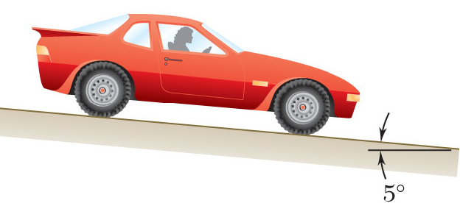
Sample Problem 13.1 1
Strategy:
Evaluate the change in kinetic energy.
Determine the distance required for the work to equal the kinetic energy change.
An automobile of mass 1000 kg is driven down a 5º incline at a speed of 72 km/h when the brakes are applied causing a constant total breaking force of 5000 N.
Determine the distance traveled by the automobile as it comes to a stop.

Slide 25
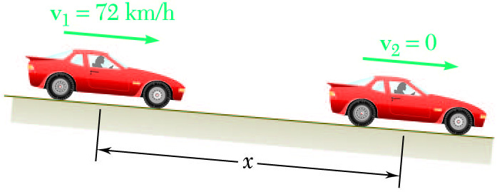
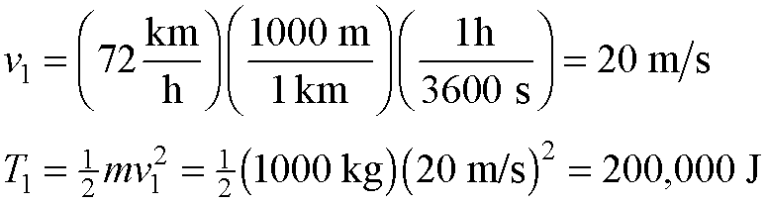
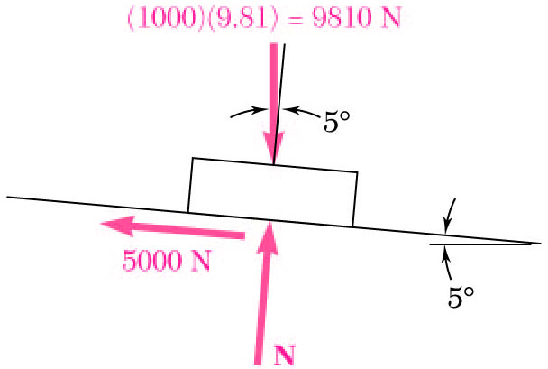
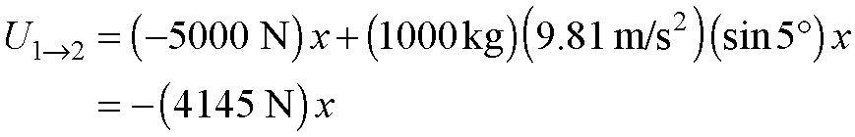
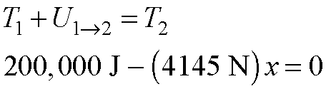
Sample Problem 13.1 2
Modeling and Analysis:
Evaluate the change in kinetic energy.
Determine the distance required for the work to equal the kinetic energy change.

Slide 26
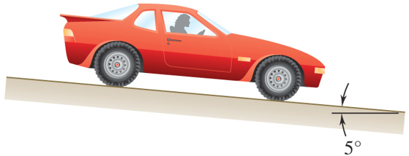
Sample Problem 13.1 3
Reflect and Think
Solving this problem using Newton’s second law would require determining the car’s deceleration from the free-body diagram and then integrating this to use the given velocity information.
Using the principle of work and energy allows you to avoid that calculation.

Slide 27
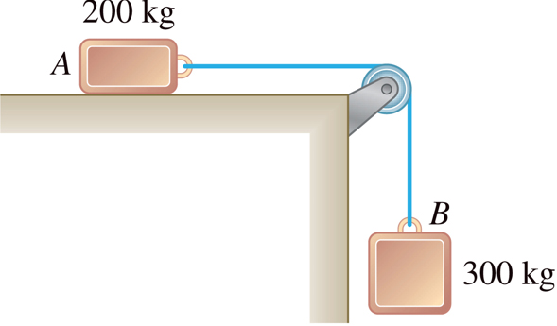
Sample Problem 13.2 1
Strategy:
Apply the principle of work and energy separately to blocks A and B.
When the two relations are combined, the work of the cable forces cancel. Solve for the velocity.
Two blocks are joined by an inextensible cable as shown. If the system is released from rest, determine the velocity of block A after it has moved 2 m. Assume that the coefficient of friction between block A and the plane is μ_{k} = 0.25 and that the pulley is weightless and frictionless.

Slide 28
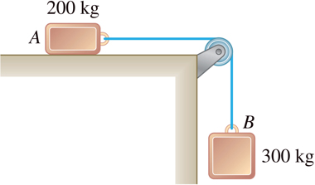
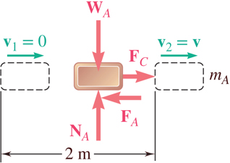
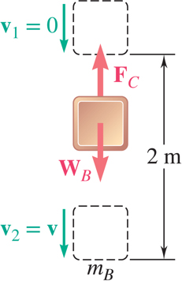
Sample Problem 13.2 2
Modeling and Analysis
Apply the principle of work and energy separately to blocks A and B.

Slide 29
Sample Problem 13.2 3
When the two relations are combined, the work of the cable forces cancel. Solve for the velocity.
Reflect and Think:
This problem can also be solved by applying the principle of work and energy to the combined system of blocks.
When using the principle of work and energy, it usually saves time to choose your system to be everything that moves.

Slide 30
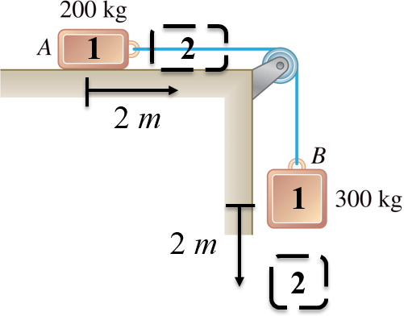
13.2 – Alternate Solution, Group Problem Solving
Could you apply work-energy to the combined system of blocks?
Given:
What is T₁ of the system?
What is the total work done between points 1 and 2?
What is T₂ of the system?
Solve for v

Slide 31
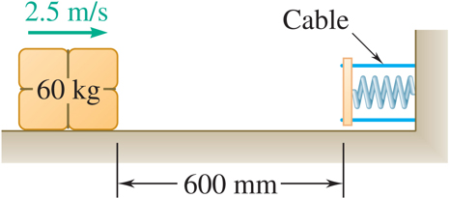
Sample Problem 13.3 1
Strategy:
Apply the principle of work and energy between the initial position and the point at which the spring is fully compressed and the velocity is zero. The only unknown in the relation is the friction coefficient.
A spring is used to stop a 60 kg package which is sliding on a horizontal surface. The spring has a constant k = 20 kN/m and is held by cables so that it is initially compressed 120 mm. The package has a velocity of 2.5 m/s in the position shown and the maximum deflection of the spring is 40 mm.
Determine (a) the coefficient of kinetic friction between the package and surface and (b) the velocity of the package as it passes again through the position shown.
Apply the principle of work and energy for the rebound of the package. The only unknown in the relation is the velocity at the final position.

Slide 32
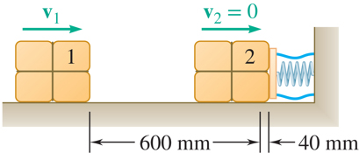
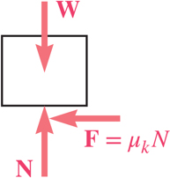
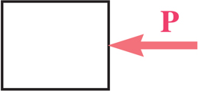
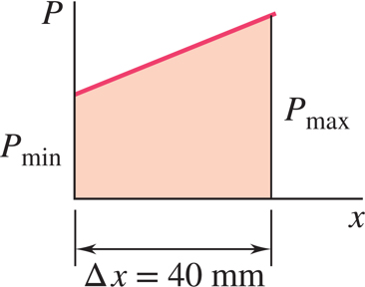
Sample Problem 13.3 2
Modeling and Analysis:
Apply principle of work and energy between initial position and the point at which spring is fully compressed.

Slide 33
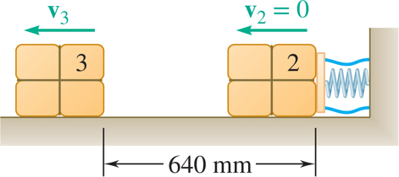
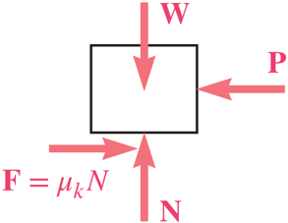
Sample Problem 13.3 3
Apply the principle of work and energy for the rebound of the package.
Reflect and Think:
You needed to break this problem into two segments. From the first segment you were able to determine the coefficient of friction. Then you could use the principle of work and energy to determine the velocity of the package at any other location. Note that the system does not lose any energy due to the spring; it returns all of its energy back to the package. You would need to design something that could absorb the kinetic energy of the package in order to bring it to rest.

Slide 34
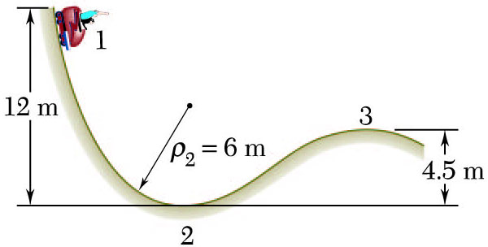
Sample Problem 13.6 1
Strategy:
Apply principle of work and energy to determine velocity at point 2.
Apply Newton’s second law to find normal force by the track at point 2.
A 1000 kg car starts from rest at point 1 and moves without friction down the track shown.
Apply principle of work and energy to determine velocity at point 3.
Apply Newton’s second law to find minimum radius of curvature at point 3 such that a positive normal force is exerted by the track.
Determine:
the force exerted by the track on the car at point 2, and
the minimum safe value of the radius of curvature at point 3.

Slide 35
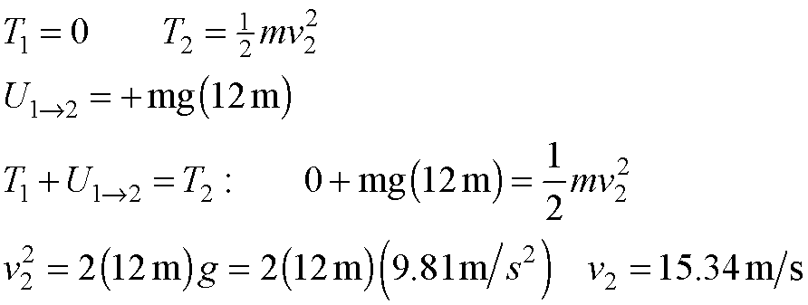
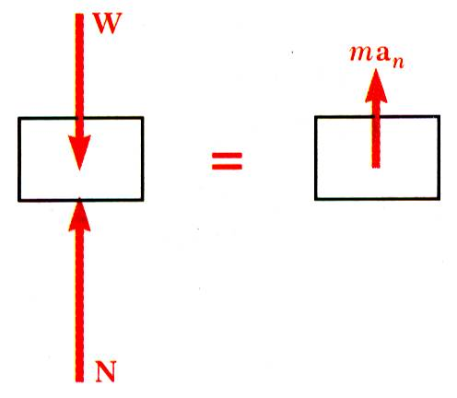
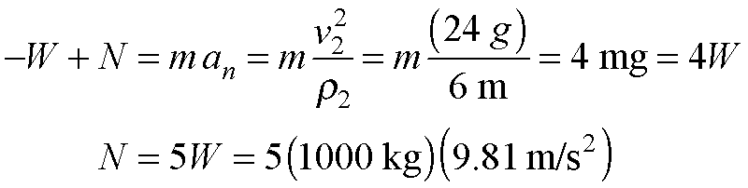
Sample Problem 13.6 2
Modeling and Analysis:
Apply principle of work and energy to determine velocity at point 2.
Apply Newton’s second law to find normal force by the track at point 2.

Slide 36
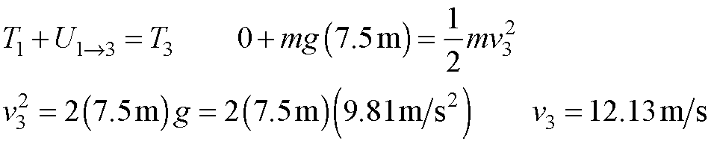
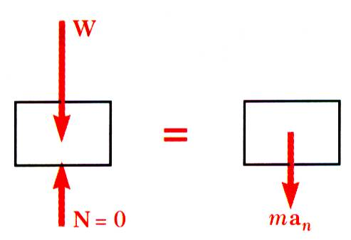
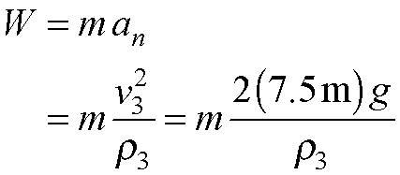
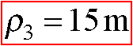
Sample Problem 13.6 3
Apply principle of work and energy to determine velocity at point 3.
Apply Newton’s second law to find minimum radius of curvature at point 3 such that a positive normal force is exerted by the track.

Slide 37
Sample Problem 13.6 4
Reflect and Think
This is an example where you need both Newton’s second law and the principle of work and energy.
Work–energy is used to determine the speed of the car, and Newton’s second law is used to determine the normal force.
A normal force of 5W is equivalent to a fighter pilot pulling 5g’s and should only be experienced for a very short time.
For safety, you would also want to make sure your radius of curvature was quite a bit larger than 15 m.

Slide 38
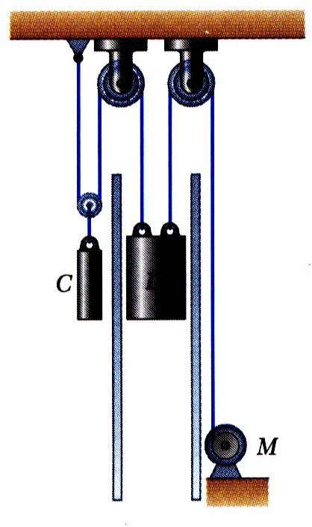
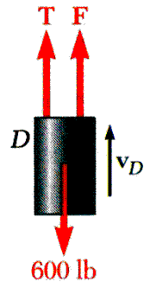
Sample Problem 13.7 1
Strategy: Force exerted by the motor cable has same direction as the dumbwaiter velocity. Power delivered by motor is equal to Fv_{D}, v_{D} = 2.5 m/s.
The dumbwaiter D and its load have a combined mass of 300 kg, while the counterweight C has a mass of 400 kg.
Determine the power delivered by the electric motor M when the dumbwaiter (a) is moving up at a constant speed of 2.5 m/s and (b) has an instantaneous velocity of 2.5 m/s and an acceleration of 1 m/s², both directed upwards.
In the first case, bodies are in uniform motion. Determine force exerted by motor cable from conditions for static equilibrium.
In the second case, both bodies are accelerating. Apply Newton’s second law to each body to determine the required motor cable force.

Slide 39
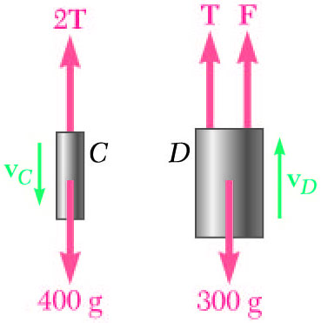
Sample Problem 13.7 2
Modeling and Analysis:
In the first case, bodies are in uniform motion. Determine force exerted by motor cable from conditions for static equilibrium.
Free-body C:
Free-body D:

Slide 40
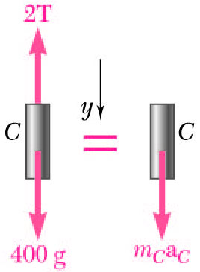
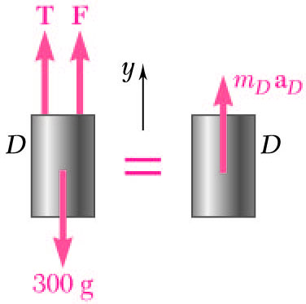
Sample Problem 13.7 3
In the second case, both bodies are accelerating. Apply Newton’s second law to each body to determine the required motor cable force.
Free-body C:
Free-body D:

Slide 41

Sample Problem 13.7 4
Reflect and Think As you might expect, the motor needs to deliver more power to produce accelerated motion than to produce motion at constant velocity.

Slide 42

Group Problem Solving 1
Strategy: The problem deals with a change in position and different velocities, so use work-energy.
Draw FBD of the box to help us determine the forces that do work.
Packages are thrown down an incline at A with a velocity of 1 m/s. The packages slide along the surface ABC to a conveyor belt which moves with a velocity of 2 m/s. Knowing that μ_{k} = 0.25 between the packages and the surface ABC, determine the distance d if the packages are to arrive at C with a velocity of 2 m/s.
Determine the work done between points A and C as a function of d.
Find the kinetic energy at points A and C.
Use the work-energy relationship and solve for d.

Slide 43


Group Problem Solving 2
Modeling and Analysis:
Draw the FBD of the block at points A and C
Determine work done A → B
Determine work done B → C

Slide 44
Group Problem Solving 3
Determine kinetic energy at A and at C
Substitute values into
Divide by m and solve for d

Slide 45

Group Problem Solving 4
Reflect and Think
If you wanted to bring the package to a complete stop at the bottom of the ramp, would it work to place a spring as shown?
No, because the potential energy of the spring would turn into kinetic energy and push the block back up the ramp
Would the package ever come to a stop?
Yes, eventually enough energy would be dissipated through the friction between the package and ramp.

Slide 46

Potential Energy 1
The potential energy stored at the top of the ball’s path is transferred to kinetic energy as the ball meets the ground. Why is the ball’s height reducing?

Slide 47
Potential Energy 2
If the work of a force only depends on differences in position, we can express this work as potential energy.
Can the work done by the following forces be expressed as potential energy?
Weight
Yes
No
Friction
Yes
No
Normal force
Yes
No
Spring force
Yes
No

Slide 48
Potential Energy 3
If the work of a force only depends on differences in position, we can express this work as potential energy.
Can the work done by the following forces be expressed as potential energy?
Weight
Yes
No
Friction
Yes
No
Normal force
Yes
No
Spring force
Yes
No

Slide 49

Potential Energy 4
Work of the force of gravity
Work is independent of path followed; depends only on the initial and final values of Wy.
= potential energy of the body with respect to force of gravity.
Choice of datum from which the elevation y is measured is arbitrary.
Units of work and potential energy are the same:

Slide 50

Potential Energy 5
Previous expression for potential energy of a body with respect to gravity is only valid when the weight of the body can be assumed constant.
For a space vehicle, the variation of the force of gravity with distance from the center of the earth should be considered.
Work of a gravitational force,
Potential energy V_{g} when the variation in the force of gravity can not be neglected,
W = Weight on surface of earth, R = radius of earth

Slide 51


Potential Energy 6
Work of the force exerted by a spring depends only on the initial and final deflections of the spring,
The potential energy of the body with respect to the elastic force,
Note that the preceding expression for V_{e} is valid only if the deflection of the spring is measured from its undeformed position.

Slide 52


Conservative Forces
Concept of potential energy can be applied if the work of the force is independent of the path followed by its point of application.
Such forces are described as conservative forces.
For any conservative force applied on a closed path,
Elementary work corresponding to displacement between two neighboring points,

Slide 53

Conservation of Energy
Work of a conservative force,
Concept of work and energy,
Follows that
When a particle moves under the action of conservative forces, the total mechanical energy is constant.
Friction forces are not conservative. Total mechanical energy of a system involving friction decreases.
Mechanical energy is dissipated by friction into thermal energy. Total energy is constant.

Slide 54


Motion Under a Conservative Central Force
When a particle moves under a conservative central force, both the principle of conservation of angular momentum
and the principle of conservation of energy
may be applied.
Given r, the equations may be solved for
At minimum and maximum
Given the
launch conditions, the equations may be solved for r_{min}, r_{max}, v_{min}, and v_{max}.

Slide 55

Sample Problem 13.8 1
Strategy:
Apply the principle of conservation of energy between positions 1 and 2.
The elastic and gravitational potential energies at 1 and 2 are evaluated from the given information. The initial kinetic energy is zero.
A 10 kg collar slides without friction along a vertical rod as shown. The spring attached to the collar has an undeflected length of 100 mm and a constant of 200 N/m.
If the collar is released from rest at position 1, determine its velocity after it has moved 150 mm to position 2.
Solve for the kinetic energy and velocity at 2.

Slide 56






Sample Problem 13.8 2
Modeling and Analysis:
Apply the principle of conservation of energy between positions 1 and 2.
Position 1:
Position 2:
Conservation of Energy:

Slide 57
Sample Problem 13.8 3
Reflect and Think
If you had not included the spring in your
system, you would have needed to treat it as an external force; therefore, you would have needed to determine the work.
Similarly, if there was friction acting on the collar, you would have needed to use the more general work–energy principle to solve this problem. It turns out that the work done by friction is not very easy to calculate because the normal force depends on the spring force.

Slide 58

Sample Problem 13.10 1
Strategy:
Since there is friction along the rough patch from A to B, conservation of energy cannot be used. Instead, apply the more general work-energy principle.
The 250-g pellet is pushed against the spring at A and released from rest. It moves along a 1.2 m rough horizontal section, then into a smooth 600 mm-radius
For the pellet to remain in contact with the loop, the force N exerted on the pellet by the loop must be equal to or greater than zero. Therefore, you also need to use Newton’s second law.
vertical loop. On the rough surface,
is 0.3, and the spring is initially compressed 75 mm. What is the minimum spring constant k for which the pellet remains in contact with the loop?

Slide 59


Sample Problem 13.10 2
Modeling and Analysis:
Setting the force exerted by the loop to zero, solve for the minimum velocity at D.
Apply the work-energy principle between positions 1 and 2.

Slide 60
Sample Problem 13.10 3
Because the normal force is equal to the weight on a horizontal surface, you can find the work done by the non-conservative
friction force,
to be:
This can be solved for k to give:

Slide 61

Sample Problem 13.10 4
Reflect and Think
A common misconception in problems like this is assuming that the speed of the particle is zero at the top of the loop, rather than that the normal force is equal to or greater than zero. If the pellet had a speed of zero at the top, it would clearly fall straight down, which is impossible.

Slide 62

Sample Problem 13.12 1
Strategy:
For motion under a conservative central force, the principles of conservation of energy and conservation of angular momentum may be applied simultaneously.
A satellite is launched in a direction parallel to the surface of the earth with a velocity of 36900 km/h from an altitude of 500 km.
Determine (a) the maximum altitude reached by the satellite, and (b) the maximum allowable error in the direction of launching if the satellite is to come no closer than 200 km to the surface of the earth
Apply the principles to the points of minimum and maximum altitude to determine the maximum altitude.
Apply the principles to the orbit insertion point and the point of minimum altitude to determine maximum allowable orbit insertion angle error.

Slide 63


Sample Problem 13.12 2
Modeling and Analysis:
Apply the principles of conservation of energy and conservation of angular momentum to the points of minimum and maximum altitude to determine the maximum altitude.
Conservation of energy:
Conservation of angular momentum:
Combining,

Slide 64


Sample Problem 13.12 3
Apply the principles to the orbit insertion point and the point of minimum altitude to determine maximum allowable orbit insertion angle error.
Conservation of energy:
Conservation of angular momentum:
Combining and solving for sin
Reflect and Think:
Space probes and other long-distance vehicles are designed with small rockets to allow for mid-course corrections. Satellites launched from the Space Station usually do not need this kind of fine-tuning.

Slide 65

Group Problem Solving 5
Strategy:
This is two part problem – you will need to find the velocity of the car using work-energy, and then use Newton’s second law to find the normal force.
Draw a diagram with the car at points A and D, and define your datum. Use conservation of energy to solve for v_{D}.
A section of track for a roller coaster consists of two circular arcs AB and CD joined by a straight portion BC. The radius of CD is 72 m. The car and its occupants, of total mass 250 kg, reach Point A with practically no velocity and then drop freely along the track. Determine the normal force exerted by the track on the car at point D. Neglect air resistance and rolling resistance.
Draw FBD and KD of the car at point D, and determine the normal force using Newton’s second law.

Slide 66

Group Problem Solving 6
Modeling and Analysis: Given: v_{A}= 0 m/s, r_{CD}= 72 m, m = 250 kg
Find: N_{D}
Define your datum, sketch the situation at points of interest
Datum
Use conservation of energy to find v_{D}
Find T_{A}
Solve for v_{D}
Find V_{A}
Find T_{D}
Find V_{D}

Slide 67
Group Problem Solving 7
Draw FBD and KD at point D
e_{n}
e_{t}
72 m
ma_{n}
W
ma_{t}
N_{D}
Use Newton’s second law in the normal direction

Slide 68

Group Problem Solving 8
Reflect and Think:
What happens to the normal force at D if….
…we include friction?
a) N_{D} gets larger
b) N_{D} gets smaller
c) N_{D} stays the same
…we move point A higher?
…the radius is smaller?
a) N_{D} gets larger
b) N_{D} gets smaller
c) N_{D} stays the same
a) N_{D} gets larger
b) N_{D} gets smaller
c) N_{D} stays the same

Slide 69
Group Problem Solving 9
Reflect and Think:
What happens to the normal force at D if….
…we include friction?
a) N_{D} gets larger
b) N_{D} gets smaller
c) N_{D} stays the same
…we move point A higher?
…the radius is smaller?
a) N_{D} gets larger
a) N_{D} gets larger
b) N_{D} gets smaller
c) N_{D} stays the same
b) N_{D} gets smaller
c) N_{D} stays the same

Slide 70


Impulsive Motion 1
The thrust of a rocket acts over a specific time period to give the rocket linear momentum.
The impulse applied to the railcar by the wall brings its momentum to zero. Crash tests are often performed to help improve safety in different vehicles.
© Sandia National Laboratories/Getty Images RF

Slide 71

Principle of Impulse and Momentum
From Newton’s second law,
linear momentum
Dimensions of the impulse of a force are
Units for the impulse of a force are
The final momentum of the particle can be obtained by adding vectorially its initial momentum and the impulse of the force during the time interval.

Slide 72

Impulsive Motion 2
Force acting on a particle during a very short time interval that is large enough to cause a significant change in momentum is called an impulsive force.
When impulsive forces act on a particle,
When a baseball is struck by a bat, contact occurs over a short time interval but force is large enough to change sense of ball motion.
Nonimpulsive forces are forces for which
is small and therefore, may be
neglected – an example of this is the weight of the baseball.

Slide 73

Sample Problem 13.13 1
Strategy:
Apply the principle of impulse and momentum. The impulse is equal to the product of the constant forces and the time interval.
An automobile weighing 1800 kg is driven down a 5º incline at a speed of 100 km/h when the brakes are applied, causing a constant total braking force of 7000 N.
Determine the time required for the automobile to come to a stop.

Slide 74


Sample Problem 13.13 2
Modeling and Analysis:
Apply the principle of impulse and momentum.
Taking components parallel to the incline,
Reflect and Think
You could use Newton’s second law to solve this problem. First, you would determine the car’s deceleration, separate variables, and then integrate a = dv/dt to relate the velocity, deceleration, and time. You could not use conservation of energy to solve this problem, because this principle does not involve time.

Slide 75

Sample Problem 13.16 1
Strategy:
Apply the principle of impulse and momentum in terms of horizontal and vertical component equations.
A 120 g baseball is pitched with a velocity of 24 m/s. After the ball is hit by the bat, it has a velocity of 36 m/s in the direction shown. If the bat and ball are in contact for 0.015 s, determine the average impulsive force exerted on the ball during the impact.

Slide 76



Sample Problem 13.16 2
Modeling and Analysis:
Apply the principle of impulse and momentum in terms of horizontal and vertical component equations.
x component equation:
y component equation:
y
x

Slide 77


Sample Problem 13.16 3
Reflect and Think:

Slide 78

Sample Problem 13.17 1
Strategy:
Apply the principle of impulse and momentum to the package-cart system to determine the final velocity.
Apply the same principle to the package alone to determine the impulse exerted on it from the change in its momentum.
A 10 kg package drops from a chute into a 24 kg cart with a velocity of 3 m/s. Knowing that the cart is initially at rest and can roll freely, determine (a) the final velocity of the cart, (b) the impulse exerted by the cart on the package, and (c) the fraction of the initial energy lost in the impact.

Slide 79


Sample Problem 13.17 2
Modeling and Analysis
Apply the principle of impulse and momentum to the package-cart system to determine the final velocity.
x components:

Slide 80


Sample Problem 13.17 3
Apply the same principle to the package alone to determine the impulse exerted on it from the change in its momentum.
x components:
y components:

Slide 81

Sample Problem 13.17 4
To determine the fraction of energy lost,
Reflect and Think:
Except in the purely theoretical case of a “perfectly elastic” collision, mechanical energy is never conserved in a collision between two objects, even though linear momentum may be conserved. Note that, in this problem, momentum was conserved in the x direction but was not conserved in the y direction because of the vertical impulse on the wheels of the cart. Whenever you deal with an impact, you need to use impulse-momentum methods.

Slide 82

Group Problem Solving 10
Strategy:
Draw impulse and momentum diagrams of the jumper.
Apply the principle of impulse and momentum to the jumper to determine the force exerted on the foot.
The jumper approaches the takeoff line from the left with a horizontal velocity of 10 m/s, remains in contact with the ground for 0.18 s, and takes
off at a
angle with a velocity of 12
m/s. Determine the average impulsive force exerted by the ground on his foot. Give your answer in terms of the weight W of the athlete.

Slide 83


Group Problem Solving 11
Modeling and Analysis:
Draw impulse and momentum diagrams of the jumper
Use the impulse momentum equation in y to find F_{avg}

Slide 84
Group Problem Solving 12
Use the impulse momentum equation in x and y to find F_{avg}
Reflect and Think:
F_{avg-x} is positive, which means we guessed correctly (acts to the left)

Slide 85

Concept Quiz 1
Car A and B crash into one another. Looking only at the impact, which of the following statements are true?
The total mechanical energy is the same before and after the impact
True
False
If car A weighs twice as much as car B, the force A exerts on car B is bigger than the force B exerts on car A.
True
False
The total linear momentum is the same immediately before and after the impact
True
False

Slide 86
Concept Quiz 2
Car A and B crash into one another. Looking only at the impact, which of the following statements are true?
The total mechanical energy is the same before and after the impact
True
False
If car A weighs twice as much as car B, the force A exerts on car B is bigger than the force B exerts on car A.
True
False
The total linear momentum is the same immediately before and after the impact
True
False

Slide 87

Impact 1
The coefficient of restitution is used to characterize the “bounciness” of different sports equipment. The U.S. Golf Association limits the C O R of golf balls at 0.83
© Ted Kinsman/Science Source

Slide 88


Impact 2
Impact: Collision between two bodies which occurs during a small time interval and during which the bodies exert large forces on each other.
Line of Impact: Common normal to the surfaces in contact during impact.
Central Impact: Impact for which the mass centers of the two bodies lie on the line of impact; otherwise, it is an eccentric impact..
Direct Central Impact
Central Impact: Impact for which the mass centers of the two bodies lie on the line of impact; otherwise, it is an eccentric impact..
Oblique Impact: Impact for which one or both of the bodies move along a line other than the line of impact.
Oblique Central Impact

Slide 89



Direct Central Impact 1
Bodies moving in the same straight line,
Upon impact the bodies undergo a period of deformation, at the end of which, they are in contact and moving at a common velocity.
A period of restitution follows during which the bodies either regain their original shape or remain permanently deformed.
Wish to determine the final velocities of the two bodies. The total momentum of the two body system is preserved,
A second relation between the final velocities is required.

Slide 90


Direct Central Impact 2
Period of deformation:
Period of restitution:
A similar analysis of particle B yields
Combining the relations leads to the desired second relation between the final velocities.
Perfectly plastic impact, e = 0:
Perfectly elastic impact, e = 1: Total energy and total momentum conserved.

Slide 91

Oblique Central Impact 1
Final velocities are unknown in magnitude and direction. Four equations are required.
No tangential impulse component; tangential component of momentum for each particle is conserved.
Normal component of total momentum of the two particles is conserved.
Normal components of relative velocities before and after impact are related by the coefficient of restitution.

Slide 92

Oblique Central Impact 2
Block constrained to move along horizontal surface.
Impulses from internal forces
along the n axis and from external force
exerted by horizontal surface and directed along the vertical to the surface.
Final velocity of ball unknown in direction and magnitude and unknown final block velocity magnitude. Three equations required.

Slide 93

Oblique Central Impact 3
Tangential momentum of ball is conserved.
Total horizontal momentum of block and ball is conserved.
Normal component of relative velocities of block and ball are related by coefficient of restitution.
Note: Validity of last expression does not follow from previous relation for the coefficient of restitution. A similar but separate derivation is required.

Slide 94

Problems Involving Multiple Principles
Three methods for the analysis of kinetics problems:
Direct application of Newton’s second law.
Method of work and energy.
Method of impulse and momentum.
Select the method best suited for the problem or part of a problem under consideration.

Slide 95

Sample Problem 13.19 1
Strategy:
Resolve ball velocity into components normal and tangential to wall.
Impulse exerted by the wall is normal to the wall. Component of ball momentum tangential to wall is conserved.
A ball is thrown against a frictionless, vertical wall. Immediately before the ball strikes the wall, its velocity has a magnitude v and forms angle of 30° with the horizontal. Knowing that e = 0.90, determine the magnitude and direction of the velocity of the ball as it rebounds from the wall.
Assume that the wall has infinite mass so that wall velocity before and after impact is zero. Apply coefficient of restitution relation to find change in normal relative velocity between wall and ball, i.e., the normal ball velocity.

Slide 96


Sample Problem 13.19 2
Modeling and Analysis:
Resolve ball velocity into components parallel and perpendicular to wall.
Component of ball momentum tangential to wall is conserved.
Apply coefficient of restitution relation with zero wall velocity.

Slide 97

Sample Problem 13.19 3
Reflect and Think:
Tests similar to this are done to make sure that sporting equipment––such as tennis balls, golf balls, and basketballs––are consistent and fall within certain specifications. Testing modern golf balls
and clubs shows that the coefficient of restitution actually decreases with increasing club speed (from about 0.84 at a speed of 145 km/hr to about 0.80 at club speeds of 210 km/hr).

Slide 98

Sample Problem 13.20 1
Strategy:
Resolve the ball velocities into components normal and tangential to the contact plane.
Tangential component of momentum for each ball is conserved.
The magnitude and direction of the velocities of two identical frictionless balls before they strike each other are as shown. Assuming e = 0.9, determine the magnitude and direction of the velocity of each ball after the impact.
Total normal component of the momentum of the two ball system is conserved.
The normal relative velocities of the balls are related by the coefficient of restitution.
Solve the last two equations simultaneously for the normal velocities of the balls after the impact.

Slide 99





Sample Problem 13.20 2
Modeling and Analysis:
Resolve the ball velocities into components normal and tangential to the contact plane.
Tangential component of momentum for each ball is conserved.
Total normal component of the momentum of the two ball system is conserved.

Slide 100





Sample Problem 13.20 3
The normal relative velocities of the balls are related by the coefficient of restitution.
Solve the last two equations simultaneously for the normal velocities of the balls after the impact.
n
t

Slide 101

Sample Problem 13.20 4
Reflect and Think:
Rather than choosing your system to be both balls, you could have applied impulse-momentum along the line of impact for each ball individually.
This would have resulted in two equations and one additional unknown, FΔt. To determine the impulsive force F, you would need to be given the time for the impact, Δt.

Slide 102

Sample Problem 13.21 1
Strategy:
Determine orientation of impact line of action.
The momentum component of ball A tangential to the contact plane is conserved.
The total horizontal momentum of the two ball system is conserved.
Ball B is hanging from an inextensible cord. An identical ball A is released from rest when it is just touching the cord and acquires a velocity v₀ before striking ball B. Assuming perfectly elastic impact (e = 1) and no friction, determine the velocity of each ball immediately after impact.
The relative velocities along the line of action before and after the impact are related by the coefficient of restitution.
Solve the last two expressions for the velocity of ball A along the line of action and the velocity of ball B which is horizontal.

Slide 103



Sample Problem 13.21 2
Modeling and Analysis:
Determine orientation of impact line of action.
The momentum component of ball A tangential to the contact plane is conserved.
The total horizontal (x component) momentum of the two ball system is conserved.

Slide 104


Sample Problem 13.21 3
The relative velocities along the line of action before and after the impact are related by the coefficient of restitution.
Solve the last two expressions for the velocity of ball A along the line of action and the velocity of ball B which is horizontal.

Slide 105

Sample Problem 13.21 4
Reflect and Think
Since e = 1, the impact between A and B is perfectly elastic. Therefore, rather than using the coefficient of restitution, you could have used the conservation of energy as your final equation.

Slide 106

Sample Problem 13.22 1
Strategy:
Apply the principle of conservation of energy to determine the velocity of the block at the instant of impact.
Since the impact is perfectly plastic, the block and pan move together at the same velocity after impact. Determine that velocity from the requirement that the total momentum of the block and pan is conserved.
A 30 kg block is dropped from a height of 2 m onto the 10 kg pan of a spring scale. Assuming the impact to be perfectly plastic, determine the maximum deflection of the pan. The constant of the spring is k = 20 kN/m.
Apply the principle of conservation of energy to determine the maximum deflection of the spring.

Slide 107


Sample Problem 13.22 2
Modeling and Analysis:
Apply principle of conservation of energy to determine velocity of the block at instant of impact.
Determine velocity after impact from requirement that total momentum of the block and pan is conserved.

Slide 108

Sample Problem 13.22 3
Apply the principle of conservation of energy to determine the maximum deflection of the spring.
Initial spring deflection due to pan weight:

Slide 109

Sample Problem 13.22 4
Reflect and Think:
The spring constant for this scale is pretty large, but the block is fairly massive and is dropped from a height of 2 m. From this perspective, the deflection seems reasonable.
We included the spring in the system so we could treat it as an energy term rather than finding the work of the spring force.

Slide 110

Group Problem Solving 13
Strategy:
This is a multiple step problem. Formulate your overall approach.
A 2-kg block A is pushed up against a spring compressing it a distance x= 0.1 m. The block is then released from rest and slides down the 20º incline until it strikes a 1-kg sphere B, which is suspended from a 1 m inextensible rope. The spring constant is k=800 N/m, the coefficient of friction between A and the ground is 0.2, the distance A slides from the unstretched length of the spring d = 1.5 m, and the coefficient of restitution between A and B is 0.8. When α = 40º, find (a) the speed of B (b) the tension in the rope.
Use work-energy to find the velocity of the block just before impact.
Use conservation of momentum to determine the speed of ball B after the impact.
Use work energy to find the velocity at α.
Use Newton’s 2nd Law to find tension in the rope.

Slide 111


Group Problem Solving 14
Modeling and Analysis:
Use work-energy to find the velocity of the block just before impact
Determine the friction force acting on the block A
Solve for N
Sum forces in the y-direction

Slide 112

Group Problem Solving 15
Set your datum, use work-energy to determine v_{A} at impact.
Determine values for each term.
Substitute into the Work-Energy equation and solve for v_{A}

Slide 113

Group Problem Solving 16
Use conservation of momentum to determine the speed of ball B after the impact
Draw the impulse diagram
Note that the ball is constrained to move only horizontally immediately after the impact.
Apply conservation of momentum in the x direction
Use the relative velocity/coefficient of restitution equation
Solve (1) and (2) simultaneously

Slide 114

Group Problem Solving 17
Use work energy to find the velocity at α
Set datum, use Work-Energy to determine v_{B} at α=40°
Determine values for each term.
Substitute into the Work-Energy equation and solve for v_{A}

Slide 115


Group Problem Solving 18
Use Newton’s 2nd Law to find tension in the rope
Draw your free-body and kinetic diagrams
Sum forces in the normal direction
Determine normal acceleration
Substitute and solve

Slide 116
Concept Question 1
Compare the following statement to the problem you just solved.
If the coefficient of restitution is smaller than the 0.8 in the problem, the tension T will be…
Smaller
Bigger
If the rope length is smaller than the 1 m in the problem, the tension T will be…
If the mass of A is smaller than the 2 kg given in the problem, the tension T will be…
Smaller
Bigger
If the coefficient of friction is smaller than 0.2 given in the problem, the tension T will be…
Smaller
Bigger
Smaller
Bigger

Slide 117
Concept Question 2
Compare the following statement to the problem you just solved.
If the coefficient of restitution is smaller than the 0.8 in the problem, the tension T will be…
Smaller
Bigger
If the rope length is smaller than the 1 m in the problem, the tension T will be…
If the mass of A is smaller than the 2 kg given in the problem, the tension T will be…
Smaller
Bigger
If the coefficient of friction is smaller than 0.2 given in the problem, the tension T will be…
Smaller
Bigger
Smaller
Bigger

Slide 118

Summary
Approaches to Kinetics Problems

Slide 119
End of Chapter 13

